Slide 1
Discrete fourier transform

Slide 2
Source code : DET function
function X = dft(x)
N = length(x);
c = j*2*pi/N;
for k=0:N-1
X(k+1) = sum(x.*exp(-c*k*[0:N-1]));
end

Slide 3
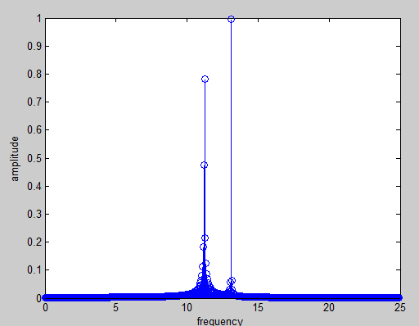
FFT:Plot sin-wave
f1=13.0899;
f2=11.2199;
fs=50;
N=0:1000;
t=N/fs;
x=sin(2*pi*f1*t)+sin(2*pi*f2*t);
y=fft(x);
L=length(N);
mag=abs(y(1:L/2))./(L/2);
f=(0:(L/2)-1).*(fs/L);
figure(3);stem(f,mag);xlabel('Angular frequency ')
ylabel('amplitude');

Slide 4
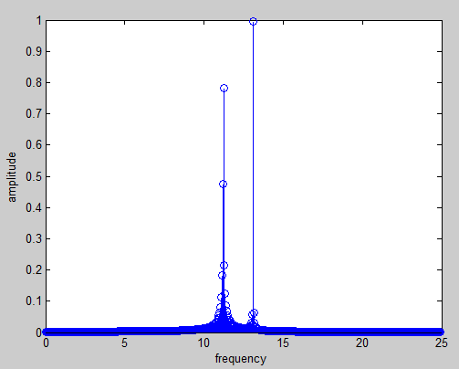
DFT:Plot sin-wave
f1=13.0899;
f2=11.2199;
fs=50;
N=0:1000;
t=N/fs;
x=sin(2*pi*f1*t)+sin(2*pi*f2*t);
y=dft(x);
L=length(N);
mag=abs(y(1:L/2))./(L/2);
f=(0:(L/2)-1).*(fs/L);
figure(3);stem(f,mag);xlabel('frequency ')
ylabel('amplitude');

